Slide 1
XML and Databases
Ref: Connolly and Begg 5th ed., Chapter 31

Slide 2
Agenda
XML for data transmission and storage
Querying XML documents
XPath, Xquery
Transforming XML documents
XSLT
XML and databases
SQL/XML
For more details see http://www.w3schools.com/xml/

Slide 3
Part 1 – A brief look at XML (eXtensible Markup Language)
A meta-language (a language for describing other languages) that enables designers to create their own customized tags.
HTML defines layout only
XML can describe layout AND data content
XML can be used to transmit data from one database to another

Slide 4
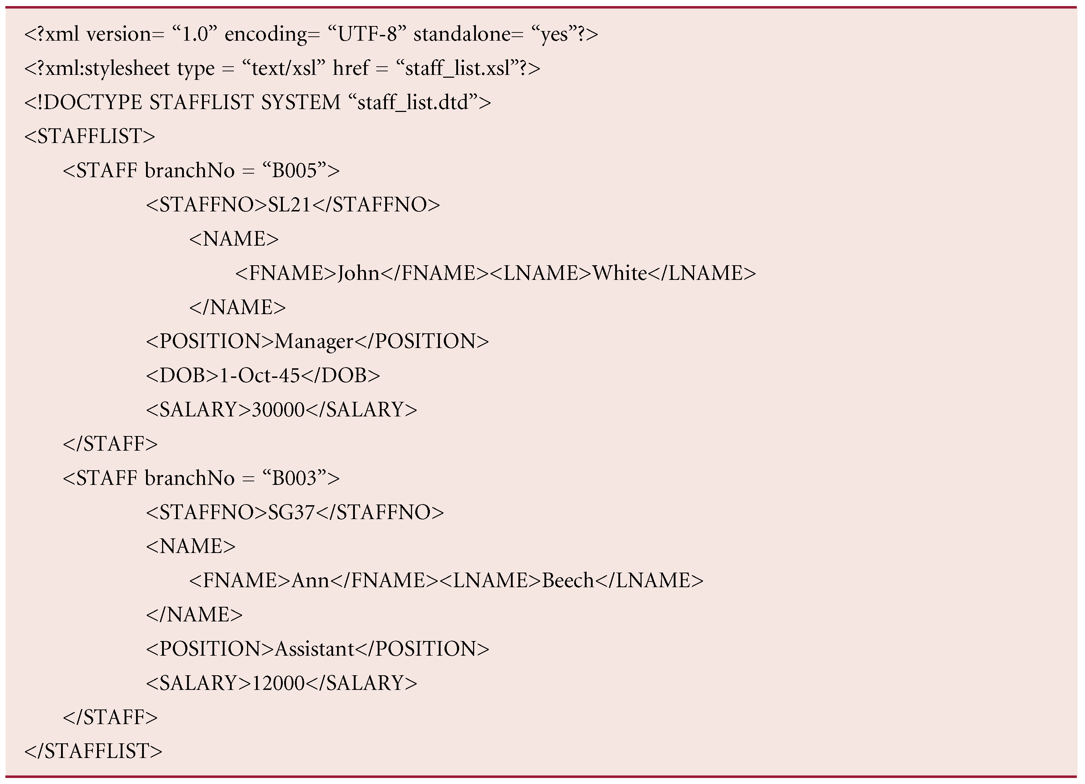
Staff example – Connolly and Begg
Optional XML declaration (version 1.1)
Encoding system used
Whether needs to be checked against another document
Refer to another DTD document discussed later
Start of root element
End of root element

Slide 5
XML Components
XML Schema/
DTD
XSLT
url
url
XML
Text
XML
Parser
Valid
XML
XML/
HTML
Write .xml file which is checked against the XML Schema.
XSLT transforms it and determines how to display it.

Slide 6
XML -Components
States that the element Stafflist contains zero or more Staff elements
XML document
Elements, or tags, are most common form of markup.
Attributes are name-value pairs that contain descriptive information about an element. E.g. <STAFF branchNo = “B005”>
XML Schema/DTD
<!element stafflist (staff)*>
<!element staff (name, position, DOB?, salary)>
<!element STAFFNO (#PCDATA)
…
Defines what is allowed in the XML document
Supports strong data typing and validity checks
Referenced from the XML document (or can be included)
States that the element Staff contains 4 elements with DOB being optional
Notes:
DTD is Document Type Definition

Slide 7
XSLT
replacement for CSS (Cascading Style Sheets)
referenced from within the XML document
XSLT (for Transformation) to transform an XML document into another XML document or (X)HTML or anything else!

Slide 8
XML for database applications
Strong data typing, validation
XSLT allows VIEW materialisation
separation of VIEWS from database (to support various end-users)
XSLT allows transformation of VIEWS from different databases
merge data, extract data from number of databases (heterogeneous or homogeneous)

Slide 9
XML and semistructured data
database data is highly structured and described by a separate schema
much data on the web (and in the real world) is semi-structured
documents, forms
Semi-structured data tends to be self-describing
XML documents are semi-structured

Slide 10
Querying XML documents
XPath to navigate through the document using DOM for the document
XQuery is designed to query XML data - not just XML files, but anything that can appear as XML, including databases.
XQuery is to XML what SQL is to database tables.

Slide 11
DOM for STAFF
STAFFLIST
STAFF
Staff
STAFFNO
NAME
POSITION
DOB
SALARY
SL21
Manager
1945-10-01
30000
FNAME
LNAME
John
White

Slide 12
XPath examples based on DOM
Staff number of first member of staff
Doc(“staff_list.xml”)/STAFFLIST/STAFF[1]//STAFFNO
-- returns
<STAFFNO>SL21</STAFFNO>
Surnames of staff at branch B005
Doc(“staff_list.xml”)/STAFFLIST/STAFF[@branchNo = “B005”]
//Lname
-- returns
<LNAME>White</LNAME>
etc.

Slide 13
XQuery examples based on XPath examples
Example 1
xquery version "1.0";
for $S in doc("Stafflist.xml")//STAFF[1]
return $S//STAFFNO
--result
<STAFFNO>SL21</STAFFNO>
Example 2
xquery version "1.0";
for $S in doc("Stafflist.xml")/STAFFLIST/STAFF
return $S[@branchNo = "B005"]//LNAME
-- result
<LNAME>White</LNAME>

Slide 14
XQuery examples
List staff with salary of £30000
let $SAL :=30000
return doc("Stafflist.xml")//STAFF[SALARY=$SAL]
Result
<STAFF branchNo = “B005”>
<STAFFNO>SL21</STAFFNO>
<NAME>
<FNAME>John</FNAME><LNAME>White</LNAME>
</NAME>
<POSITION>Manager</POSITION>
<DOB>1945-10-01</DOB>
<SALARY>30000</SALARY>
</STAFF>

Slide 15
XQuery examples
List staff at branch B005 with a salary greater than £15000
for $S in doc("Stafflist.xml")//STAFF
where $S/SALARY > 15000 and $S[@branchNo="B005"]
return $S/STAFFNO
Result
<STAFFNO>SL21</STAFFNO>
.
.
.
<STAFFNO>-----</STAFFNO>

Slide 16
Staff Example – Connolly and Begg
<?xml version="1.0" encoding="UTF-8"?>
<?xml-stylesheet type="text/xsl" href="Stafflist.xslt"?>
<STAFFLIST>
<STAFF branchNo = "B005">
<STAFFNO>SL21</STAFFNO>
<NAME>
<FNAME>John</FNAME><LNAME>White</LNAME>
</NAME>
<POSITION>Manager</POSITION>
<DOB>1945-10-01</DOB>
<SALARY>30000</SALARY>
</STAFF>
<STAFF branchNo = "B003">
<STAFFNO>SG37</STAFFNO>
<NAME>
<FNAME>Ann</FNAME><LNAME>Beech</LNAME>
</NAME>
<POSITION>Assistant</POSITION>
<SALARY>12000</SALARY>
</STAFF>
</STAFFLIST>

Slide 17
XSLT – transformed Staff
<?xml version="1.0" encoding="UTF-8"?>
<STAFF>
<NAME>John White</NAME>
<NAME>Ann Beach</NAME>
</STAFF>
Enables transfer of data between heterogeneous databases with different schemas

Slide 18
Storing XML data in databases
XML data type
XML document stored as attribute value
Xpath/XQuery to query
‘Shredding’ XML document
store XML values as attribute values in the database
‘Publishing’ XML document
assemble XML document from a table(s)
produces XML Schema, XSL stylesheet, XML document
SQL/XML in SQL2008-2014

Slide 19
SQL/XML - creating XML attribute
XML datatype to store an XML document as an attribute value – run this and examine in SQL Server
CREATE TABLE [MedicalRecords](
[PatientID] [int] IDENTITY(1,1) NOT NULL,
[PatientRecord] [xml] NOT NULL,
[ModifiedDate] [datetime] NOT NULL DEFAULT (getdate()),
PRIMARY KEY CLUSTERED
( [PatientID] ASC
) ON [PRIMARY]
) ON [PRIMARY]
GO
CREATE PRIMARY XML INDEX idx_PatientRecord on [MedicalRecords] (PatientRecord)
GO
CREATE XML INDEX idx_PatientRecord_Path on [MedicalRecords] (PatientRecord) USING XML INDEX idx_PatientRecord FOR PATH

Slide 20
SQL/XML – inserting XML data
Inserting XML data
INSERT INTO MedicalRecords (PatientRecord, ModifiedDate)
VALUES(‘<PatientRecord> <PatientDetails>
<Name>Robert</Name>
<Gender>Male</Gender>
<Age>5</Age>
<InsuranceInfo><Company>Blue Cross BlueShield</Company>
<ID>D8456798</ID>
</InsuranceInfo>
</PatientDetails>
<HospitalDetails>
<Name>KK Hospital</Name>
<Department>Pediatrics</Department>
</HospitalDetails>
<AdmissionDetails>
<RegistrationNo>D4321</RegistrationNo>
<DateAdmitted>2004-05-02</DateAdmitted>
<DateDischarged>2004-05-08</DateDischarged>
</AdmissionDetails>
<ProblemDetails>
<Symptoms>
<Symptom>Abdominal pain</Symptom>
<Symptom>Dehydration</Symptom>
</Symptoms>
<Diagnosis>Diarrhea</Diagnosis>
<TreatmentInfo>
<Therapy>Oral Rehydration Therapy</Therapy>
<PrescriptionDetails>
<Item>Pepto-Bismol</Item>
<Item>Electrolyte Solutions</Item>
</PrescriptionDetails>
</TreatmentInfo>
</ProblemDetails>
</PatientRecord>',2012-01-04)

Slide 21
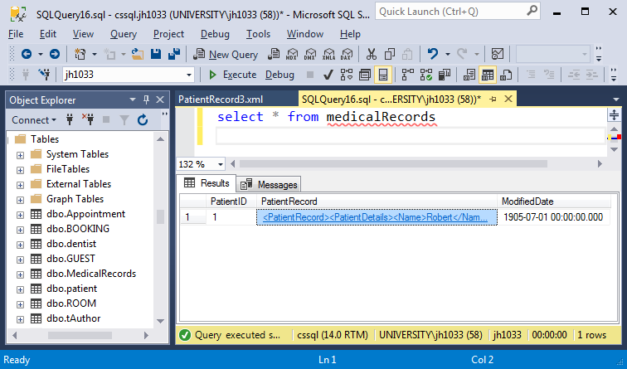
What does it look like?

Slide 22
SQL/XML - Publishing and shredding
SQL/XML defines a mapping from tables to XML documents i.e. publishing
SQL/XML does not define the inverse mapping from XML to tables i.e. shredding. Why not?
Structured to semi-structured (tables -> XML) OK in general
Semi-structured to structured (XML -> tables) not OK in general
Proprietary systems to handle many common cases

Slide 23
References
Connolly and Begg 5th ed.chapter31
Ronald Burret, Consulting, writing, and research in XML and databases
http://www.rpbourret.com/xml/XMLAndDatabases.htm

